Slide 1
Validation of AFC with new frads
Using notebook:
AFC/dev/Development-ControllerWrapper.ipynb

Slide 2
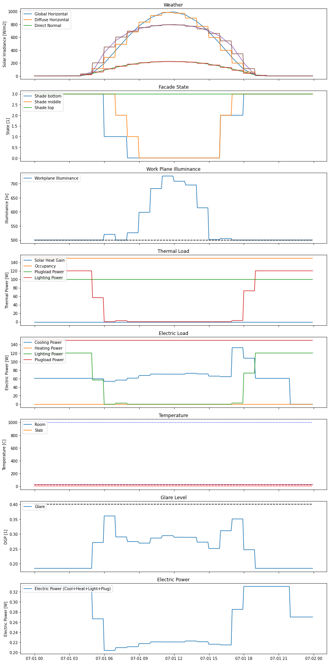
Original (before 2024-01-09)
All Input variables: dict_keys(['paths', 'radiance', 'df_input', 'wf_all', 'facade_initial', 'temps_initial', 'parameter']) WARNING: view_angle: Window below viewpoint. Log-message: Duration [s] 1.93 Objective [$] 19.43 7.54 (Total Cost) Cost [$] 12.33 (Energy) 6.98 (Demand) CO2 Emissions [kg] 0.0 Duration: {'rad_duration': 6.788450002670288, 'varts_duration': 0.16558170318603516, 'optall_duration': 2.0320236682891846, 'glare_duration': 69.14601540565491, 'opt_duration': 1.9331698417663574, 'outputs_duration': 0.00854635238647461, 'duration': 78.15548706054688} Optimization: {'opt_objective': 19.42866262, 'opt_duration': 1.9331698417663574, 'opt_termination': 'optimal', 'duration': 78.15548706054688}

Slide 3
Rerun (on 2024-01-09)
=> Same
All Input variables: dict_keys(['paths', 'radiance', 'df_input', 'wf_all', 'facade_initial', 'temps_initial', 'parameter']) WARNING: view_angle: Window below viewpoint. Log-message: Duration [s] 1.9 Objective [$] 19.43 7.54 (Total Cost) Cost [$] 12.33 (Energy) 6.98 (Demand) CO2 Emissions [kg] 0.0 Duration: {'rad_duration': 10.146118402481079, 'varts_duration': 0.15834474563598633, 'optall_duration': 1.995708703994751, 'glare_duration': 64.3870062828064, 'opt_duration': 1.8987033367156982, 'outputs_duration': 0.009083032608032227, 'duration': 76.71099305152893} Optimization: {'opt_objective': 19.42866262, 'opt_duration': 1.8987033367156982, 'opt_termination': 'optimal', 'duration': 76.71099305152893}

Slide 4
forecast.py (current – dockerV2)
python3 -m radiance.forecast
Running example for: 0.6 dshade shade
0.8429980278015137
0.548633337020874
0.6233675479888916
Forecast of 24h x 5min in 0.62 s
abs1_0_0 abs1_0_1 abs1_0_2 abs1_0_3 ... wpi_0_3 wpi_0_4 wpi_0_5 wpi_0_6
2017-09-01 18:15:00 25.889552 25.765405 25.640965 25.517768 ... 92.104732 109.873674 179.004370 217.221446
2017-09-01 18:20:00 23.476383 23.364080 23.251643 23.140250 ... 78.272840 93.434623 152.091978 184.264399
[2 rows x 49 columns]
2017-09-01 18:15:00 217.221446
2017-09-01 18:20:00 184.264399
Name: wpi_0_6, dtype: float64

Slide 5
forecast.py (current – dockerV3)
python3 -m radiance.forecast
Running example for: 0.6 dshade shade
0.809744119644165
0.7663769721984863
0.6384155750274658
Forecast of 24h x 5min in 0.64 s
abs1_0_0 abs1_0_1 abs1_0_2 abs1_0_3 ... wpi_0_3 wpi_0_4 wpi_0_5 wpi_0_6
2017-09-01 18:15:00 25.889552 25.765405 25.640965 25.517768 ... 92.104732 109.873674 179.004370 217.221446
2017-09-01 18:20:00 23.476383 23.364080 23.251643 23.140250 ... 78.272840 93.434623 152.091978 184.264399
[2 rows x 49 columns]
2017-09-01 18:15:00 217.221446
2017-09-01 18:20:00 184.264399
Name: wpi_0_6, dtype: float64

Slide 6
forecast.py (current – dockerV3 – regen)
python3 -m radiance.forecast
Running example for: 0.6 dshade shade
0.6484506130218506
0.44074106216430664
0.4946753978729248
Forecast of 24h x 5min in 0.5 s
abs1_0_0 abs1_0_1 abs1_0_2 abs1_0_3 ... wpi_0_3 wpi_0_4 wpi_0_5 wpi_0_6
2017-09-01 18:15:00 25.889586 25.765439 25.640998 25.517801 ... 92.523636 110.242874 179.606043 217.700183
2017-09-01 18:20:00 23.476419 23.364115 23.251678 23.140284 ... 78.631390 93.754110 152.617728 184.675154
[2 rows x 49 columns]
2017-09-01 18:15:00 217.700183
2017-09-01 18:20:00 184.675154
Name: wpi_0_6, dtype: float64

Slide 7
forecast2.py (new frads – dockerV3)
python3 -m radiance.forecast2
Running example for: 0.6 dshade shade
0.8646149635314941
0.6285040378570557
0.7197439670562744
Forecast of 24h x 5min in 0.72 s
abs1_0_0 abs1_0_1 abs1_0_2 abs1_0_3 ... wpi_0_3 wpi_0_4 wpi_0_5 wpi_0_6
2017-09-01 18:15:00 28.583857 28.454511 28.325165 28.195819 ... 85.508225 105.386704 166.349920 203.080418
2017-09-01 18:20:00 25.821817 25.705468 25.589119 25.472770 ... 72.056058 88.875598 140.074955 170.660370
[2 rows x 49 columns]
2017-09-01 18:15:00 203.080418
2017-09-01 18:20:00 170.660370
Name: wpi_0_6, dtype: float64

Slide 8
forecast2.py (new frads – dockerV3 – regen)
python3 -m radiance.forecast2
Running example for: 0.6 dshade shade
0.9736161231994629
0.833266019821167
0.37993431091308594
Forecast of 24h x 5min in 0.38 s
abs1_0_0 abs1_0_1 abs1_0_2 abs1_0_3 ... wpi_0_3 wpi_0_4 wpi_0_5 wpi_0_6
2017-09-01 18:15:00 28.583857 28.454511 28.325165 28.195819 ... 85.795371 105.318957 166.436095 202.853449
2017-09-01 18:20:00 25.821817 25.705468 25.589119 25.472770 ... 72.299484 88.812744 140.147054 170.479759
[2 rows x 49 columns]
2017-09-01 18:15:00 202.853449
2017-09-01 18:20:00 170.479759
Name: wpi_0_6, dtype: float64

Slide 9
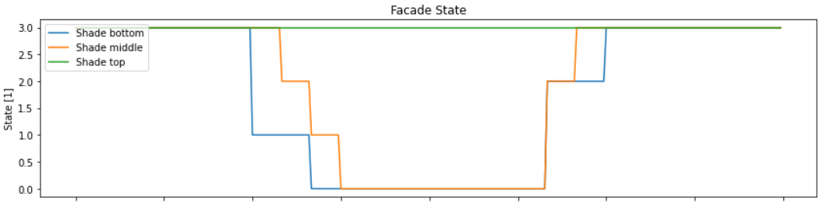
New frads (on 2024-01-09)
All Input variables: dict_keys(['paths', 'radiance', 'df_input', 'wf_all', 'facade_initial', 'temps_initial', 'parameter']) WARNING: view_angle: Window below viewpoint. Log-message: Duration [s] 1.93 Objective [$] 19.43 7.54 (Total Cost) Cost [$] 12.33 (Energy) 6.98 (Demand) CO2 Emissions [kg] 0.0 Duration: {'rad_duration': 6.788450002670288, 'varts_duration': 0.16558170318603516, 'optall_duration': 2.0320236682891846, 'glare_duration': 69.14601540565491, 'opt_duration': 1.9331698417663574, 'outputs_duration': 0.00854635238647461, 'duration': 78.15548706054688} Optimization: {'opt_objective': 19.42866262, 'opt_duration': 1.9331698417663574, 'opt_termination': 'optimal', 'duration': 78.15548706054688}

Slide 10
New frads and dockerV3 (on 2024-01-09)

Slide 11
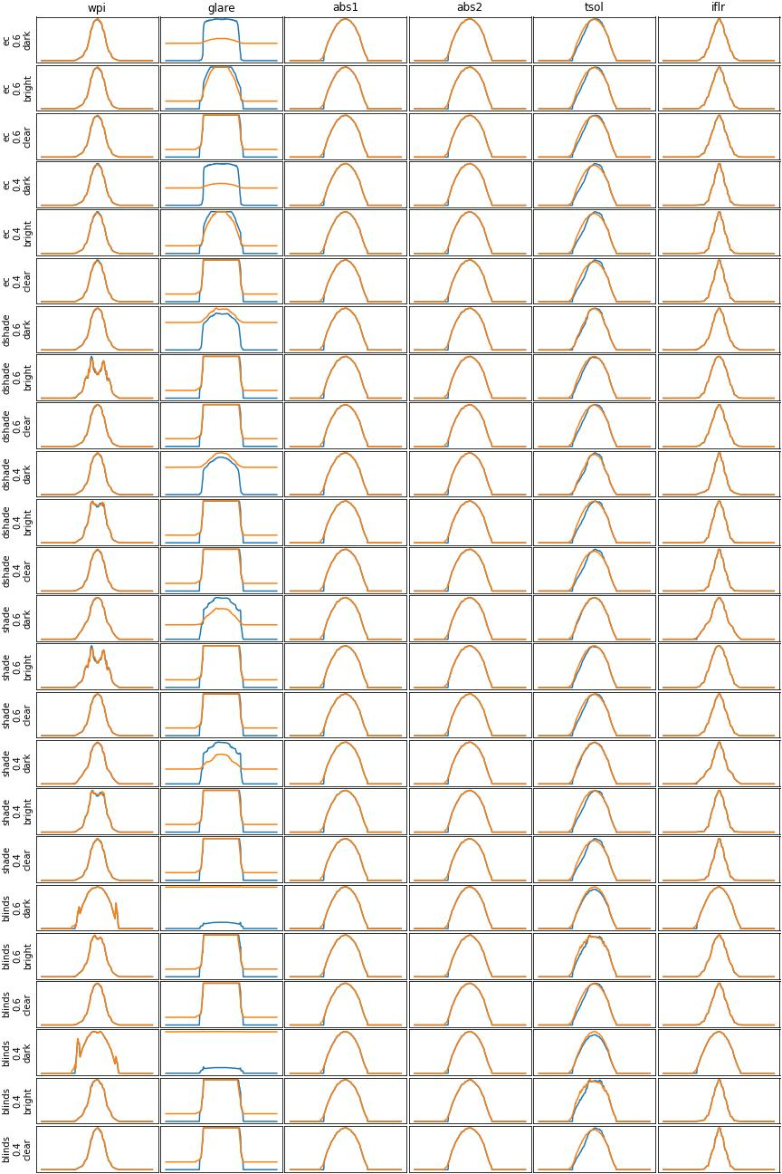
Old frads (dockerv3)

